Slide 1
Metis Project 1: EDA of MTA Turnstile for WTWY
By: Team 5
Sean Davern, Scott Kroeger, Kristen Tokunaga

Slide 2
Harnessing Data Analytics to Benefit WomenTechWomenYes International
Street teams Placement Plan
↑ Awareness ↑ Sign ups
↑ Gala attendance
↑$
Notes:
Problem = Motivation, Objective, Goals
An email exchange with a client
Chad, Cliff and Roberto -
It was great to meet with you and chat at the event where we recently met and had a nice chat. We’d love to take some next steps to see if working together is something that would make sense for both parties.
As we mentioned, we are interested in harnessing the power of data and analytics to optimize the effectiveness of our street team work, which is a significant portion of our fundraising efforts.
WomenTechWomenYes (WTWY) has an annual gala at the beginning of the summer each year. As we are new and inclusive organization, we try to do double duty with the gala both to fill our event space with individuals passionate about increasing the participation of women in technology, and to concurrently build awareness and reach.
To this end we place street teams at entrances to subway stations. The street teams collect email addresses and those who sign up are sent free tickets to our gala.
Where we’d like to solicit your engagement is to use MTA subway data, which as I’m sure you know is available freely from the city, to help us optimize the placement of our street teams, such that we can gather the most signatures, ideally from those who will attend the gala and contribute to our cause.
The ball is in your court now—do you think this is something that would be feasible for your group? From there we can explore what kind of an engagement would make sense for all of us.
Best,
Karrine and Dahlia
WTWY International
During this presentation we’re going to present our recommendations for a street team placement plan. The focus of the plan is to optimize the effectiveness of street teams who are working to:
increase awareness of WTWY
convert that awareness into a willingness to provide their email address in exchange for free annual gala tickets
increase gala attendance
find individuals passionate about increasing participation of women in technology
and ultimately increase fund raising
Draft Proposal:
WTWY street teams
Problem statement:
WTWY needs to optimize their street teams so that they can get the most email signups for their annual OMGYN Gala. Ideally, the email signups will convert at a high rate to gala attendees, and among attendees, many will make contributions to WTWY.
MTA data obtained from the NYC Data Portal provides rich information about the travel patterns of New Yorkers -- using this information, can we create a street team deployment plan that will optimize WTWY’s resources toward achieving their goals?

Slide 3

Methods
We Combined/Analyzed Data From:
Spring 2019 MTA Subway Usage
Subway Station Locations
Tech Sector Location Research
Identify Subway Stations with both:
Highest probability for finding tech employees
Highest traffic volumes
Notes:
High-Traffic Subway Entrances
Obtain: MTA Subway Data for Feb/Mar 2019
Scrub:
Entry/Exit Cumulative Values
Subway Station Locations
Explore: Entries & Exits
Karrine & Dahlia -
Hope you are well! We pulled the mta data from the public data portal and ran some initial feasibility analyses. Check out the attached document. With the MTA data alone, we can definitely help you to find places to deploy your teams to access the most people per day. We also included a few more ideas of different scales that would greatly improve the effectiveness our analyses could have toward achieving your goals.
Let us know what you think—we can set up a call to go through this with you, maybe this Thursday or Friday after 3?

Slide 4
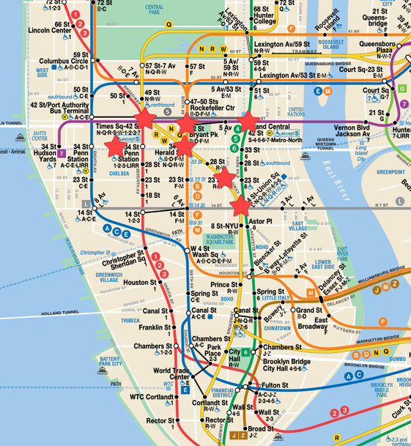
Recommendations
Street Teams Work:
Weekdays
At these stations:
34th St Penn Station
42nd St - Grand Central Station
42nd St Times Sq
34th St - Herald Square
23rd St
14th St - Union Sq

Slide 5

Questions?
Notes:
Conclusion:
We had a lot of fun wrangling the mta data and coming up with these simple plots. Based on your interests and scope, we can go ahead with anything discussed above, or meet to iterate on these themes. We’re really looking forward to working with you! Women in tech is an issue we love to support.

